Slide 1
Chongqing University of Technology
ATAI
Advanced Technique of Artificial Intelligence
Chongqing University of Technology
Knowledge-based Review Generation by Coherence Enhanced Text Planning
Junyi Li^{1,2}, Wayne Xin Zhao^{1,2∗}, Zhicheng Wei³, Nicholas Jing Yuan³and Ji-Rong Wen^{1,2}
¹Gaoling School of Artificial Intelligence, Renmin University of China
²Beijing Key Laboratory of Big Data Management and Analysis Methods
³Huawei Cloud
{lijunyi,jrwen}@ruc.edu.cn, {batmanfly, nicholas.jing.yuan}@gmail.com, weizhicheng1@huawei.com
——SIGIR 2021
2021.6.20 • ChongQing
Reported by Sijin Liu

Slide 2
Chongqing University of Technology
ATAI
Advanced Technique of Artificial Intelligence
Chongqing University of Technology
1.Introduction
2.Method
3.Experiments
4.Conclusion

Slide 3
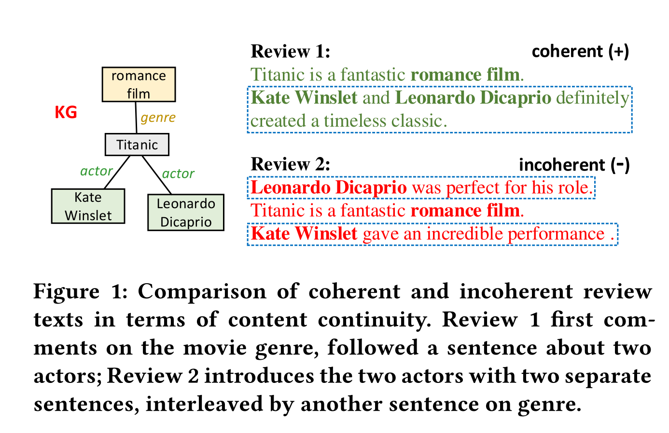
Introduction
Review generation aims to automatically produce review text conditioned on some necessary context inputs (e.g., users, items and ratings)
These approaches typically lack overall consideration to select and arrange the incorporated KG data, which is likealy to cause the issue of text incoherence, such as content discontinuity and logic confusion.

Slide 4
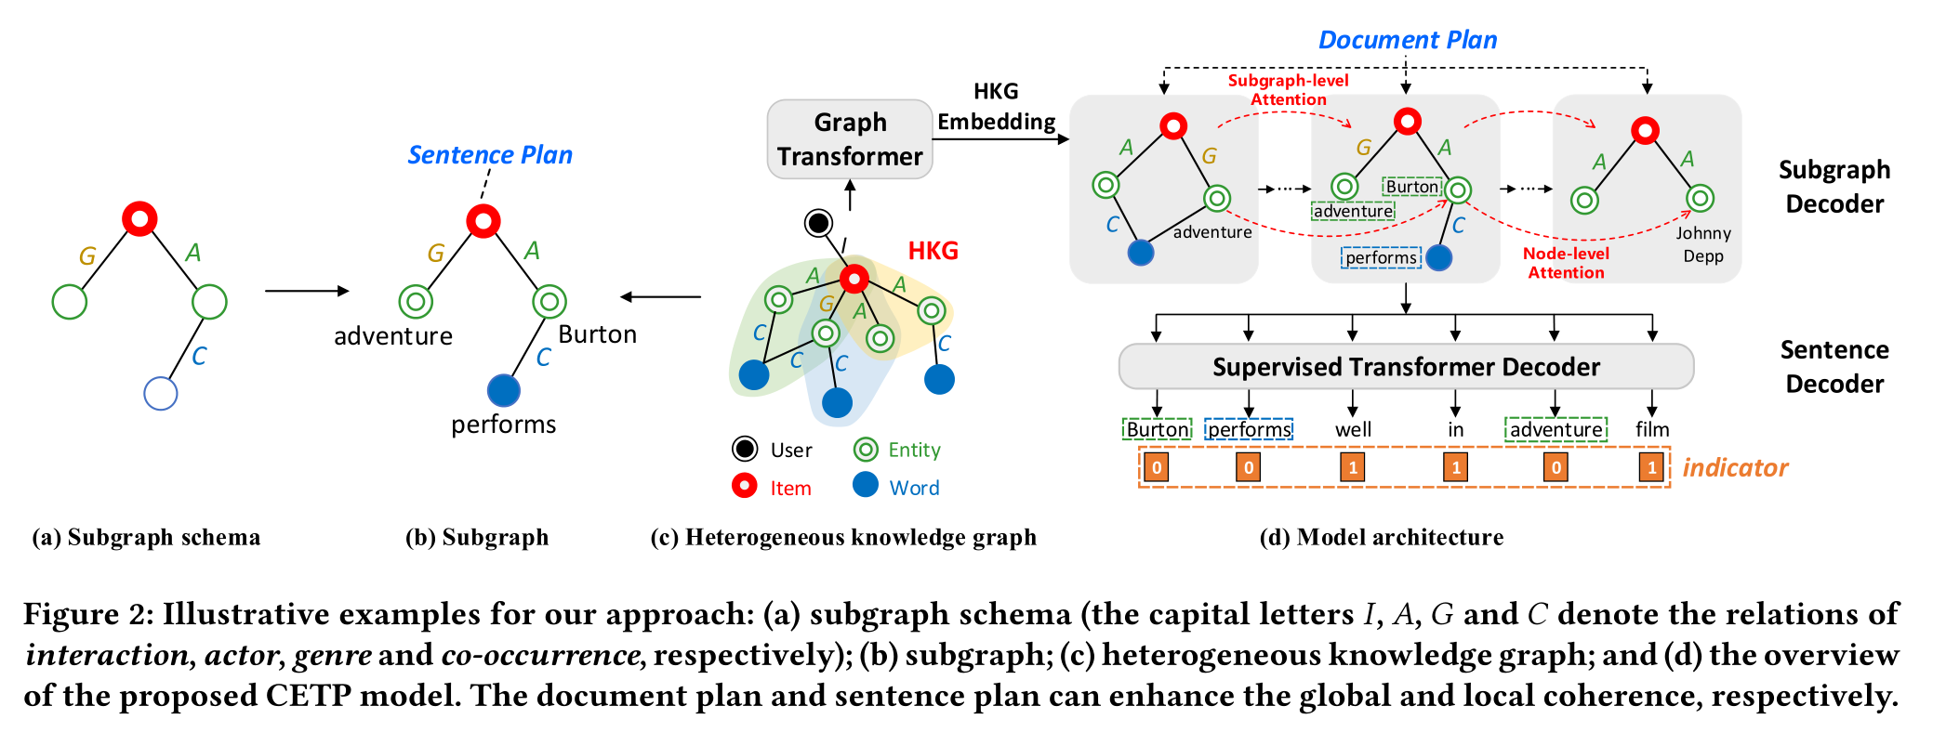
Method

Slide 5
Method
Basic Notations
We add user-item links according to their interactions and entity-keyword links if they frequently co-occur in review sentences.

Slide 6
Method
HKG Embedding

Slide 7
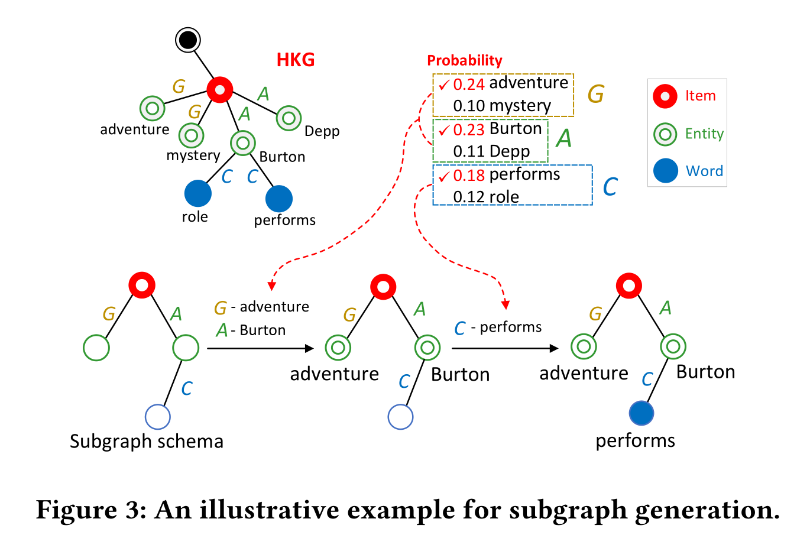

Slide 8
Subgraph Encoder
Subgraph-level Attention
Node-level Attention

Slide 9
Sentence Realization

Slide 10
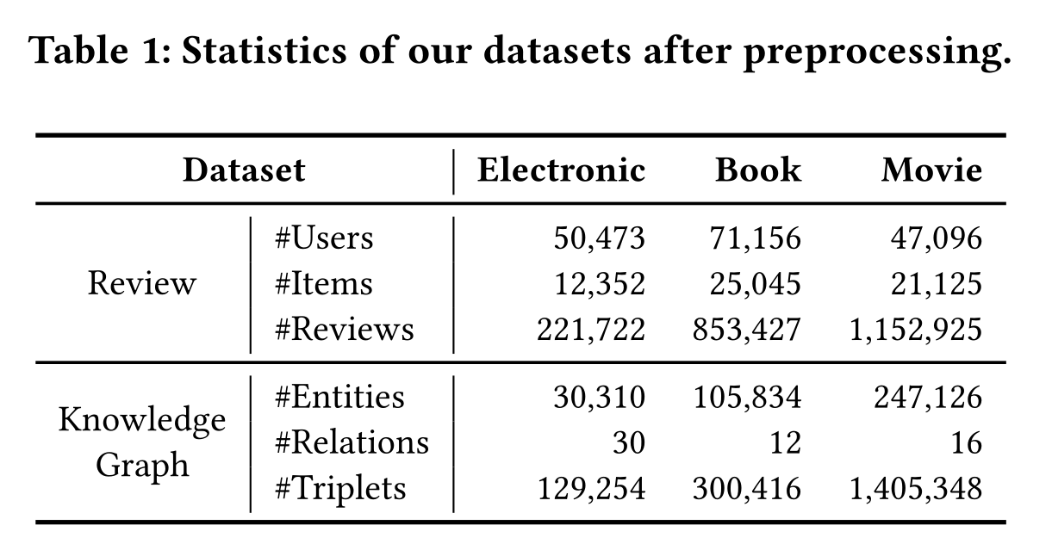
Experiments

Slide 11
Experiments

Slide 12
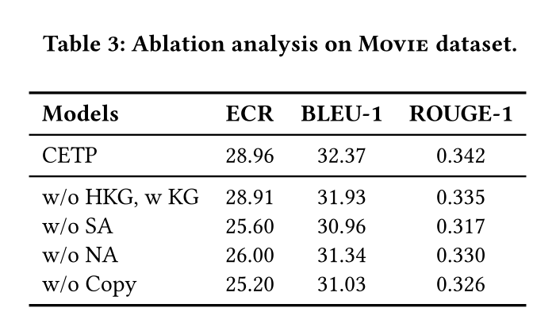
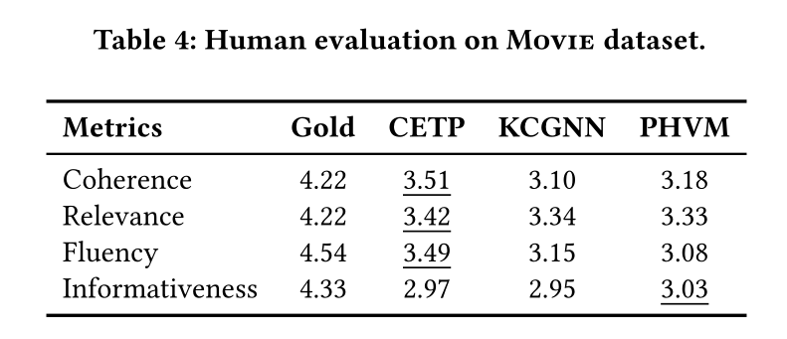
Experiments

Slide 13
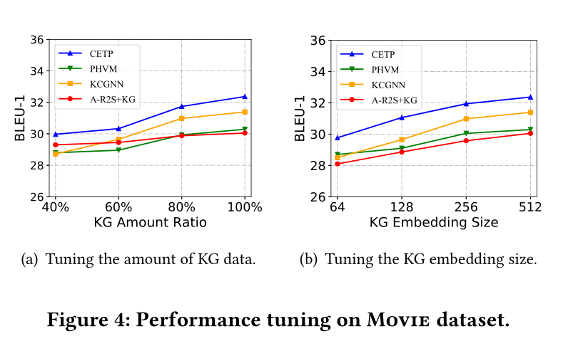
Experiments

Slide 14
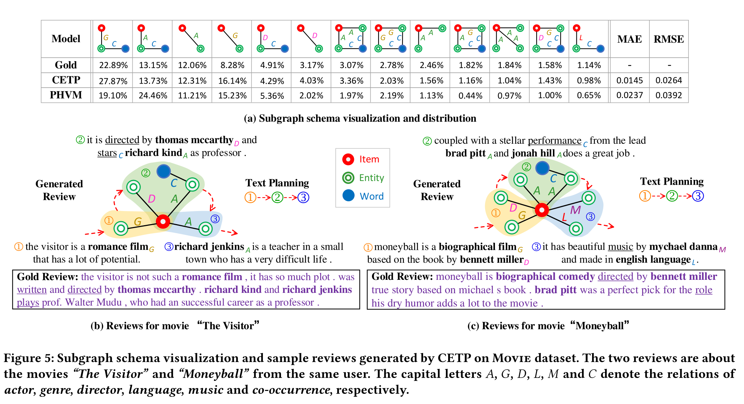
Experiments

Slide 15
Thank you!

